Slide 1



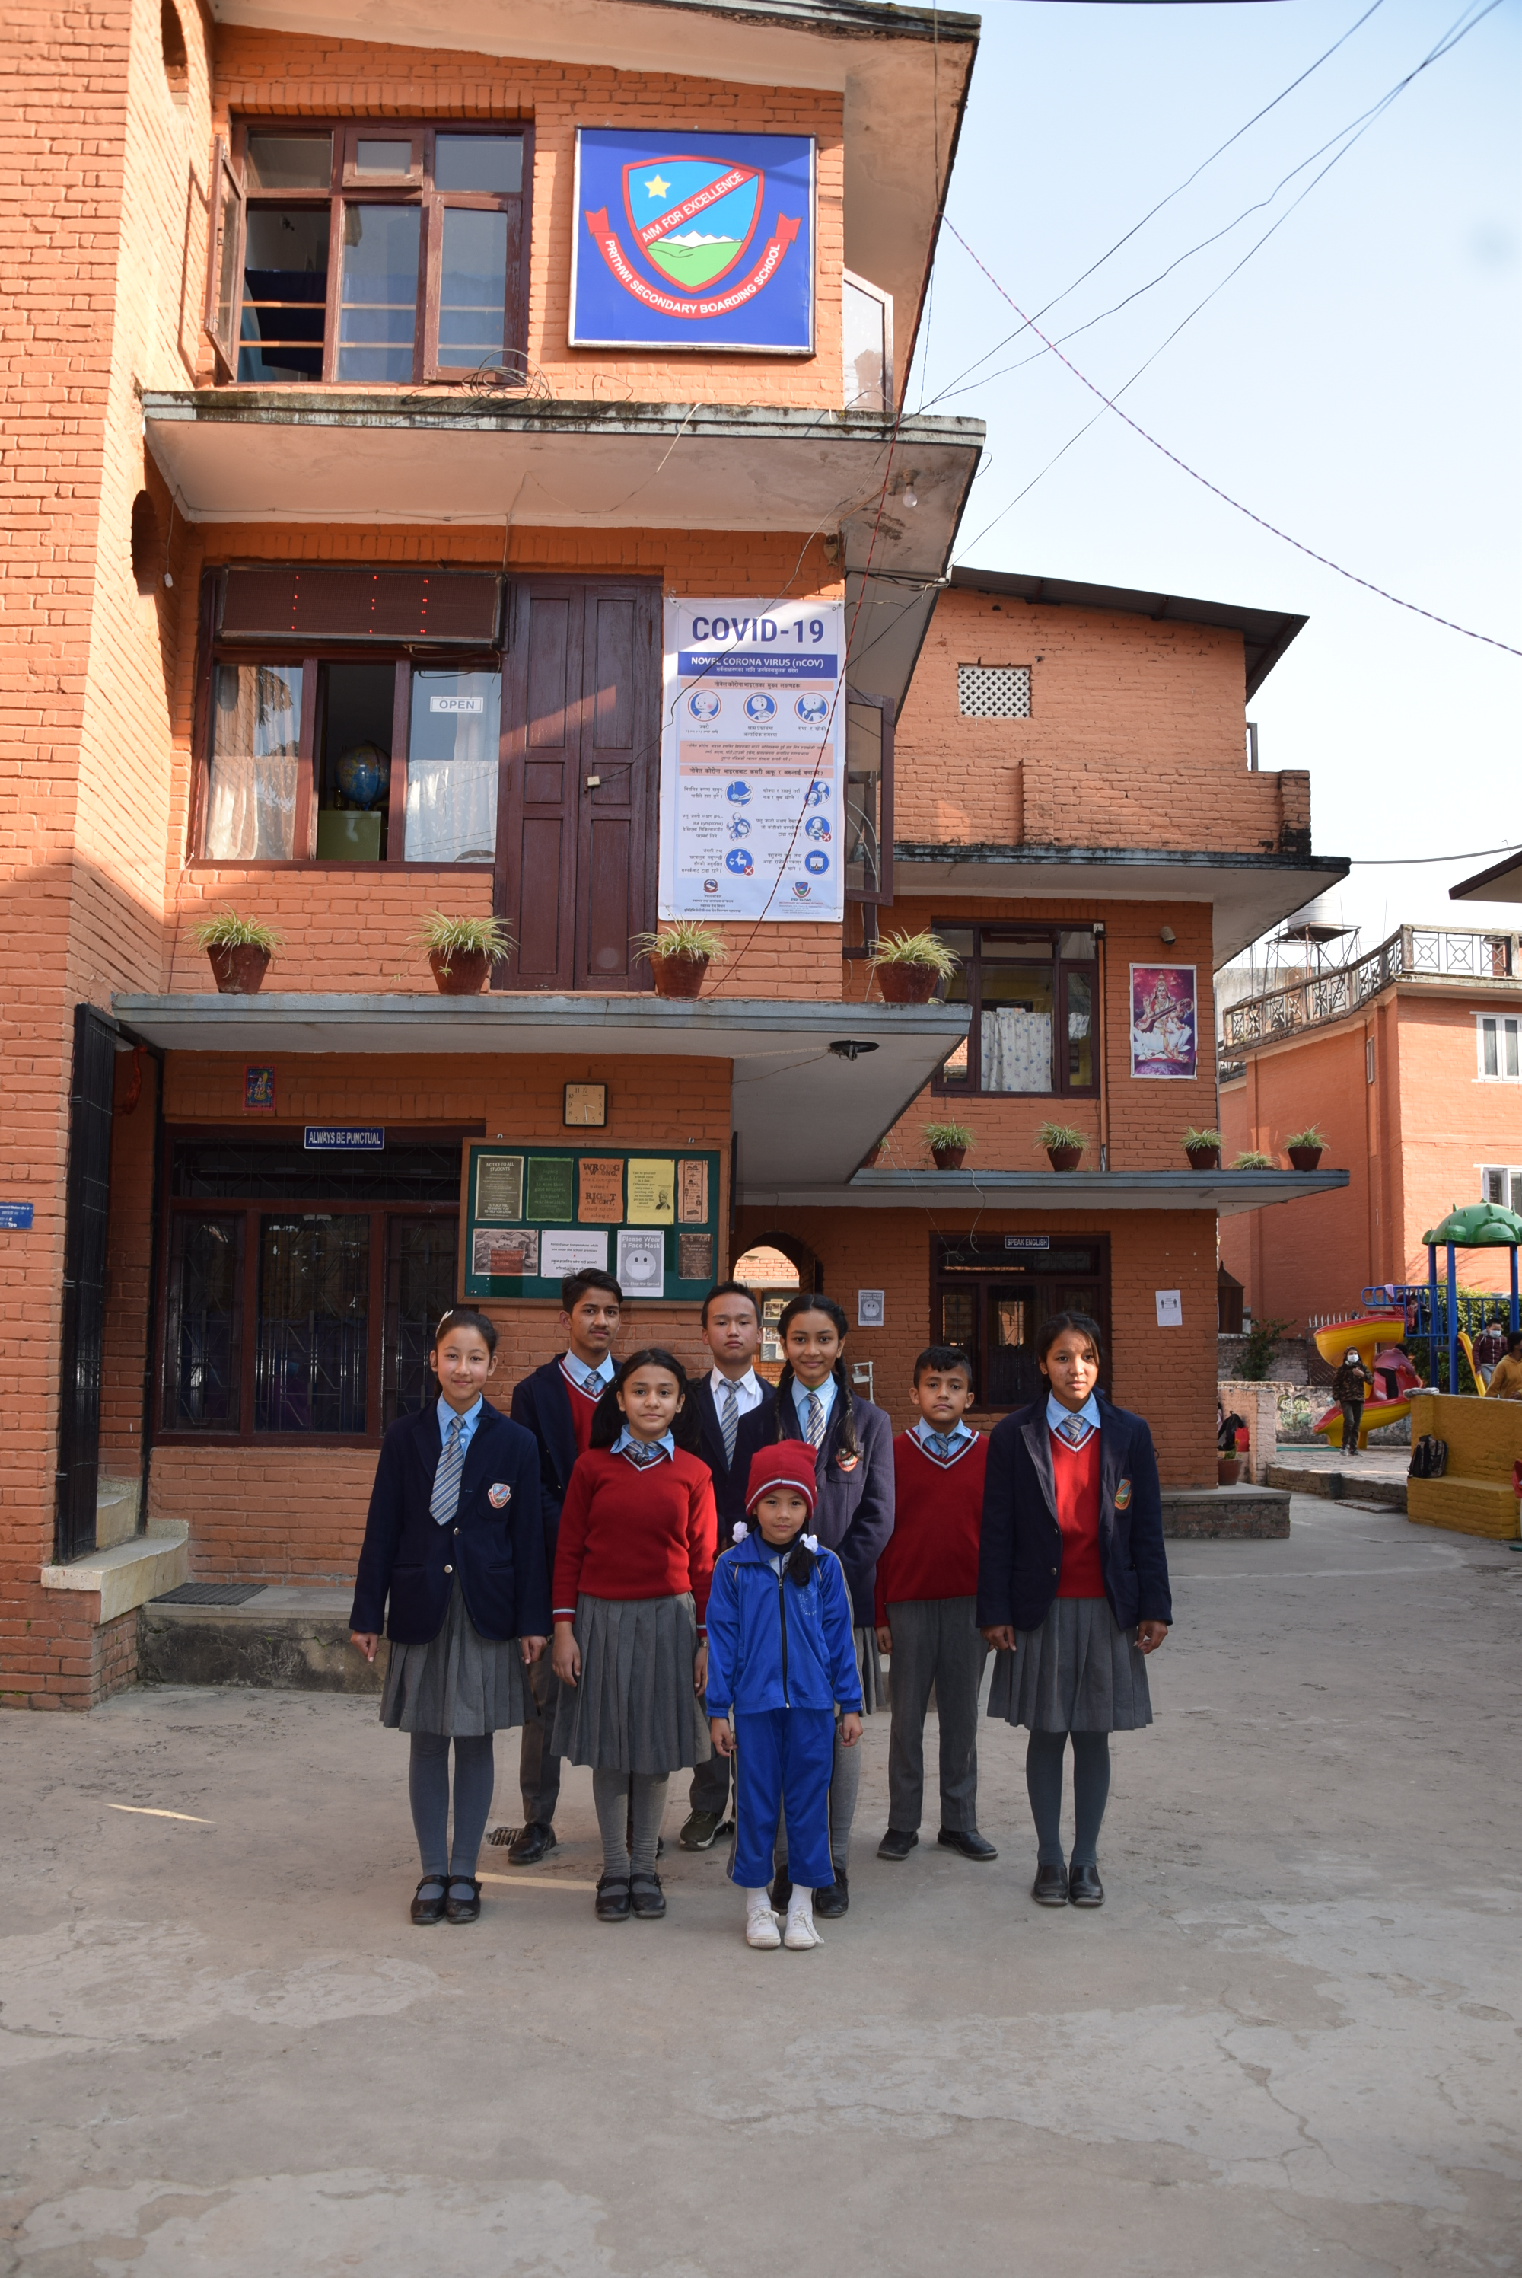

Admission Open
for
Grade I - IX
PSBS mission is
“Aim for Excellence”
Register Now
Prithwi Secondary Boarding School
Basundhara Dol, Tokha-5, Kathmandu
01-5904816
info@prithwischool.edu.np
prithwischool.edu.np

